Slide 1

Presented By:
Hammad sunsara(C-51)
Aakib Mansuri(C-21)
Internal Guide: Prof. Suhas Nagori

Slide 2

Shopify Online Shopping

Slide 3
No. of Topics | Topics
1 | Problem Definition
2 | Objective of the New System
3 | Core Components
4 | Need of the new system
5 | Scope of the new system
6 | Project Profile
7 | Advantages and Limitations of the Proposed System
8 | Proposed Time Line Chart
9 | Targeted User
10 | Requirement Determination
11 | Requirement Specification
12 | Use Case Diagram
13 | Data Dictionary
14 | User Interface Design
15 | Report Design
16 | Coding standards
No. of Topics | Topics
17 | Test Cases
18 | Proposed Enhancement
19 | Conclusion
20 | Bibliography
Content

Slide 4
Problem Definition
Identify the need for an online Shopify store to provide customers with a convenient platform to browse and purchase Product.
Security is a significant concern for online shoppers, especially when it comes to making payments. Building trust and ensuring the security of customer data is crucial to the success of the project.
Identify the issues with current offline product shopping
Lack of convenience and time-consuming
To develop a user-friendly online E-Commerce store a wide range of all products.
Inconvenient return and exchange policies

Slide 5
Objective of the New System
User-Friendly Interface: Design an intuitive and responsive user interface that enables easy navigation and smooth browsing of products.
Extensive Product Catalog: Create a vast product catalog with various categories, enabling users to find their desired products easily.
Improving customer Satisfaction: Satisfying customer needs, one objective of ecommerce, includes ensuring that the products and services provided fulfills the requirements of the customer. This can be done through making sure of accuracy in product information, providing useful guides and tutorials, and responding quickly to questions.

Slide 6
Core Components
Home Page: A visually appealing home page featuring featured products, deals, and announcements.
Product Listing Pages: Pages showcasing products in various categories with filtering and sorting options.
Product Detail Page: Detailed product information, images, customer reviews, and related products.
User Registration and Login: Secure user registration and login functionality with email verification.
Shopping Cart: An interactive shopping cart that allows users to add, update, and remove items before checkout.

Slide 7
Need of the New System
Changing consumer preferences towards online shopping
Growing demand for a convenient and accessible footwear store
Increase in internet penetration and digital payments
A feature-rich and reliable E-commerce website will help gain a competitive edge in the market
Competitive advantage in the footwear market

Slide 8
Scope of the New System
Offer a wide range of product like mobile ,computer etc.
Include various brands and price ranges
Expand to include accessories like socks and shoe care products
Cater to domestic and international customers
The current system is confined only to the shopping cart process. It can be extended to have a easy to use check out process.

Slide 9
Project Profile
Project Name | shopify online shooping
Objective | The Main Objective of the Website is to reduce the stress and time of the Business person by generating invoices, managing products, Customer, and recording sales data.
Technology | Front End: HTML,CSS,JAVASCRIPT Back End: CORE PHP, My SQL
Duration | 4-months

Slide 10
Advantages and Limitation of the proposed System
Advantages:
Advantage of the system is that it is very easy to Reset the Password of the user and delete, add to cart products when it found unnecessary.
Users can order products via websites.
Only Admin have all the rights for managing all the product rate/quantity/size etc.
One of the biggest advantages of ecommerce to business that keep sellers interested in online selling is cost reduction.

Slide 11
Limitations:
Limited Access: Since the system is not hosted on a server, it can only be accessed by those who have physical access to the computer on which it is installed. This limits access to the system.
Offline payment is not available

Slide 12
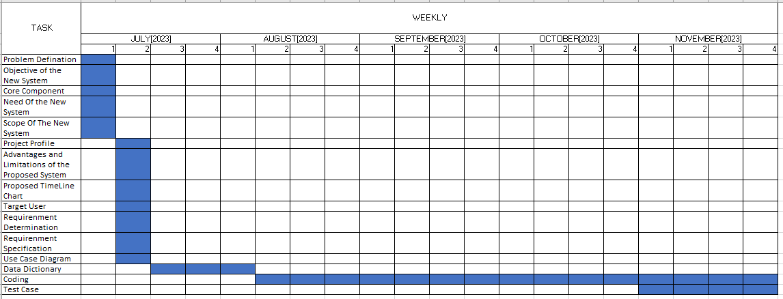
Proposed Time Line Chart

Slide 13
Targeted User
Fashion-conscious individuals
Budget Shoppers
Work wear Shoppers
Parents and Guardians
Size and Fit Concerned Shoppers
Shoe enthusiasts and collectors
Busy professionals seeking convenience
International customers looking for unique Product

Slide 14
Requirement Determination
Similar Application/Websites Study:
We have analyzed different websites & understood that what we should provide in this system
Questionnaires:
We have also asked some questions to our faculty members & got some information from them also.
Group Discussion:
From group discussion we have finalized the modules which will be present in our system.

Slide 15
Requirement Specification
Functional Requirements:
Admin side:
Admin can Login in the system using login credentials.
Admin can manage his/her Profile like admin can View user profile.
Admin can manage Quantity details, product’s details, product order.
Admin can manage feedbacks/Question of products Related. Admin can also reply to the feedback sender Through Email.

Slide 16
Users side:
User can login in the system using login credentials.
User can manage their profile.
User can send feedback/Question to the admin.
Security Requirements:
The entire database should have backup in case of data loss.

Slide 17
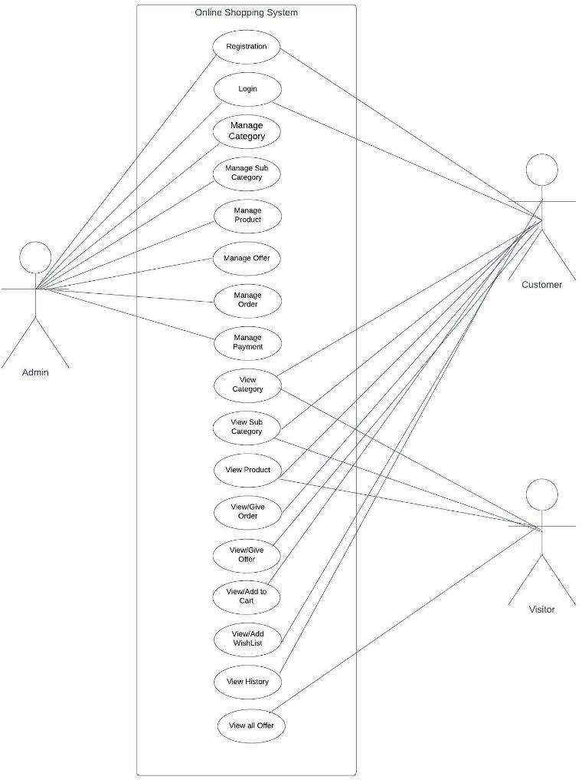
Use case Diagram

Slide 18
Data Dictionary
Sr. No. | Table Name
1 | Login Details
2 | User Details
3 | Product Details
4 | Sales Order
5 | Sales Order Details
6 | Cart Details
7 | Category Details

Slide 19
Table Name : Login Details
Primary Key : Userid
Description :This table used to store login Details of user and admin
.
Field Name | Data Type (with size) | Constraints | Sample Data
Userid | Int(11) | Primary Key | 1
username | Varchar(255) | Not Null | Admin
Email | Text | Not Null | abc@@gmail.com
Password | Varchar(255) | Not Null | 12345
UserType | integer | Not Null | Admin/user

Slide 20
Table Name : User Details
Primary Key : User_id
Foreign Key :NA
Description :It will store Details of User
.
Field Name | Data Type (with size) | Constraints | Sample Data
user_id | Int(3) | PRIMARY KEY | 1
Name | Varchar(25) | Not null | Aakib
Contact_num | Int(10) | Not null | 7984657474
email | varchar(255) | Not null | xyz@gmail.com
Address | varchar(255) | Not null | ahmedabad

Slide 21
Table Name : product Details
Primary Key : product_id
Description :it will store details of product
Field Name | Data Type (with size) | Constraints | Sample Data
Productid | Int(5) | Primary Key | 1
Categoryid | Int(5) | Not null | 2
Name | varchar(255) | Not null | Laptop
Description | varchar(50) | Not null | I3 8gen
Price | double(50) | Not null | 40500
Quantity | integer(5) | Not null | 03
imageUrl | Varchar(200) | Not null | Laptop1.jpg

Slide 22
Table Name : salesorder
Primary Key : order_id
Description :it will store details of sales order
Field Name | Data Type (with size) | Constraints | Sample Data
Orderid | Int(5) | Primary Key | 1
DateTime | Date | Not null | 02-10-2023
Amount | Double | Not null | 50000
Bill status | varchar(255) | Not null | Pending
Order Status | varchar(255) | Not null | generated

Slide 23
Table Name : SalesorderDetails
Primary Key : Order_id, productid
Description :it will store of details shipping
Field Name | Data Type (with size) | Constraints | Sample Data
Orderid | Int(11) | Primary Key | 1
Productid | Int(50) | Not null | 002
Size | int(10) | Not null | 001
Quantity | int(10) | Not null | 002
Amount | Double | Not null | 0987654321

Slide 24
Table Name : CartDetails
Primary Key : USer_id,
Description :it will store of details of cart page of user
Field Name | Data Type (with size) | Constraints | Sample Data
Userid | Int(3) | Primary key | 1
productid | Int(3) | Not null | 40
Quantity | Int(11) | Not null | 2
amount | Double | Not null | 12500.00

Slide 25
Table Name : CategoryDetails
Primary Key : catogryid
Description :it will store of details category of product
Field Name | Data Type (with size) | constarint | value
Categoryid | Int(5) | Primary key | 1
Name | Varchar(255) | Not null | Electronic
subcategory | Varchar(255) | Not null | Smartphone

Slide 26
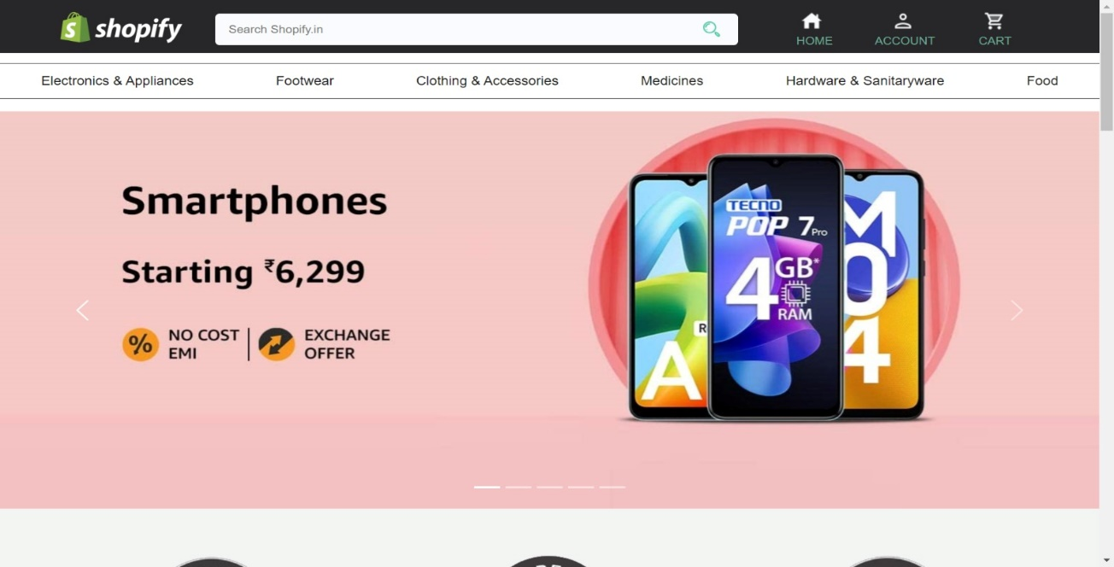
User Interface Design
1) Home Page

Slide 27
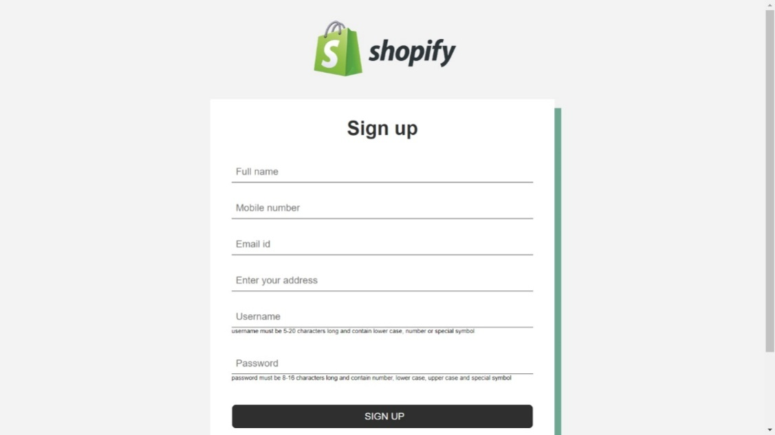
2) Sign up Page

Slide 28
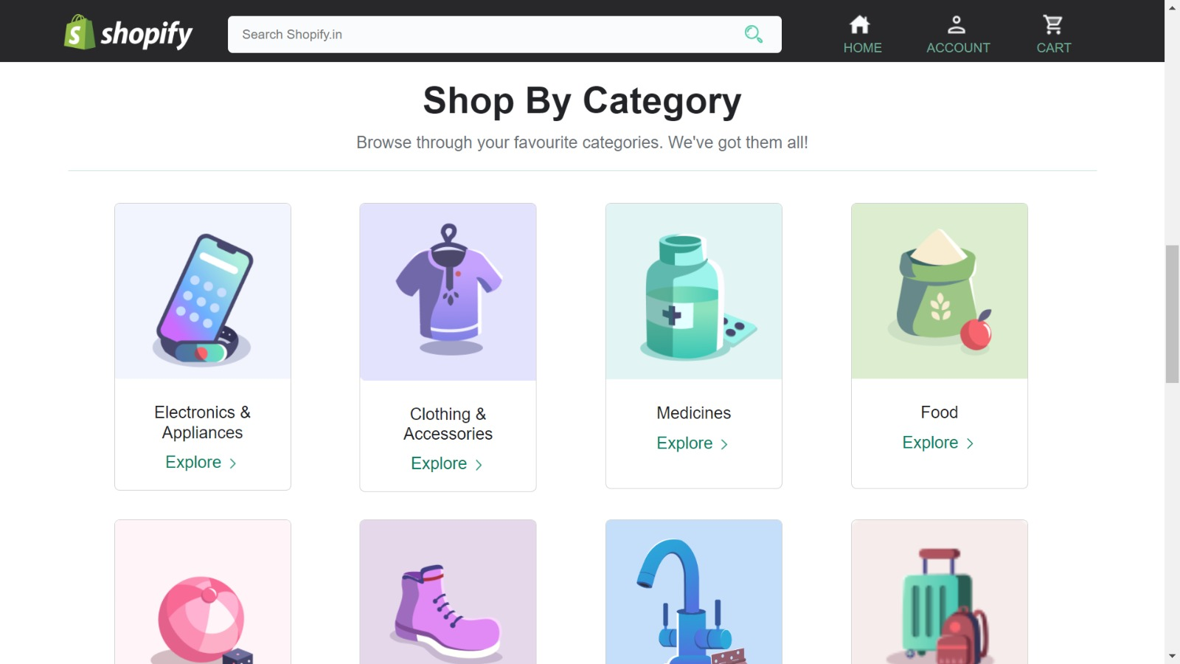
3) Category Page

Slide 29
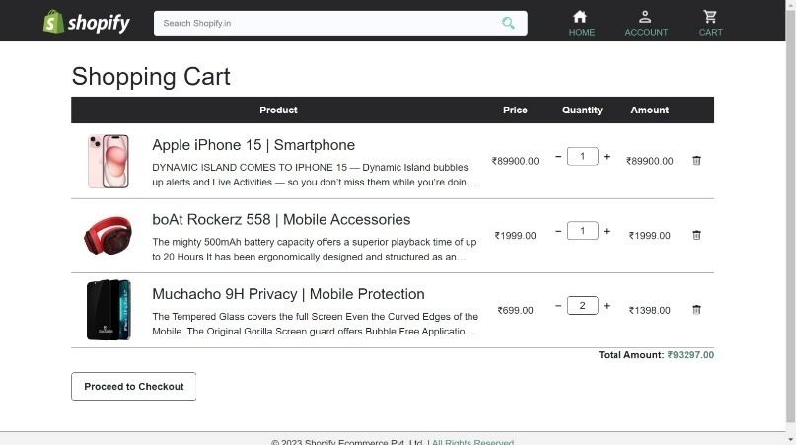
4) Cart Page

Slide 30
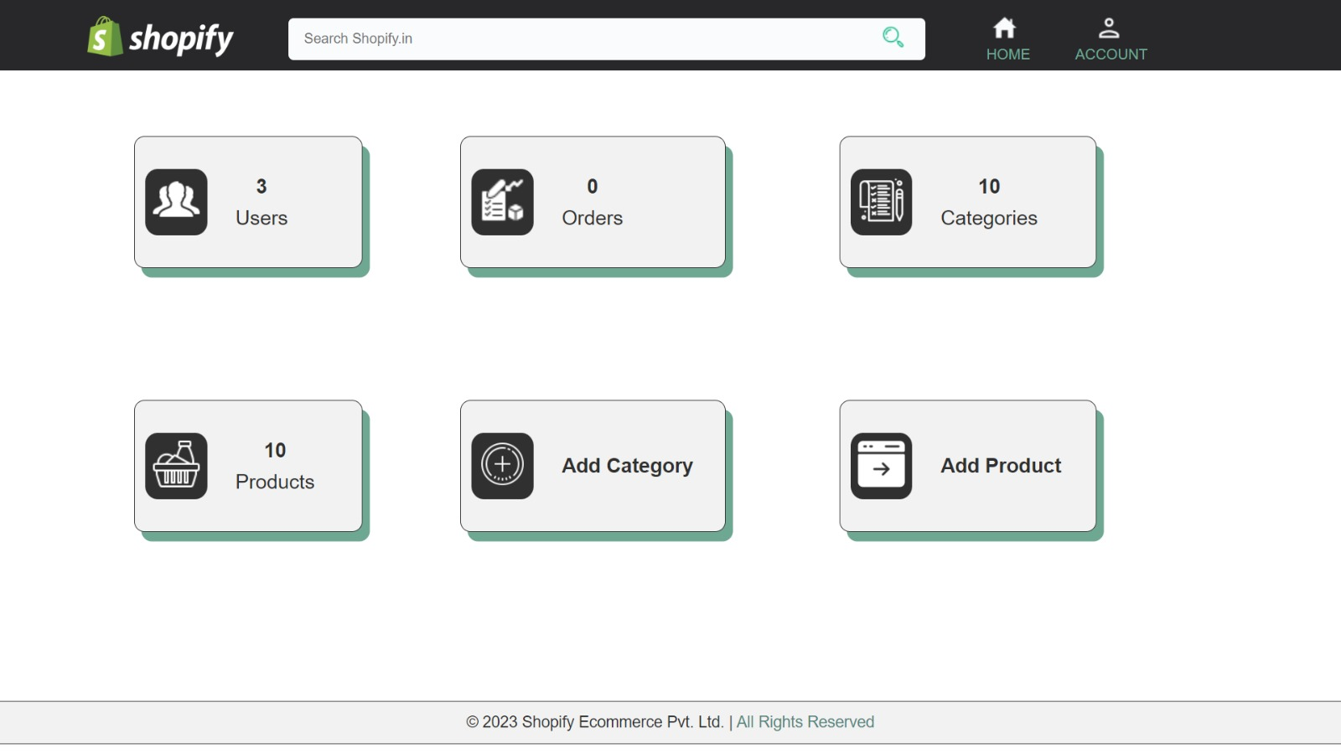
4) Admin Side

Slide 31
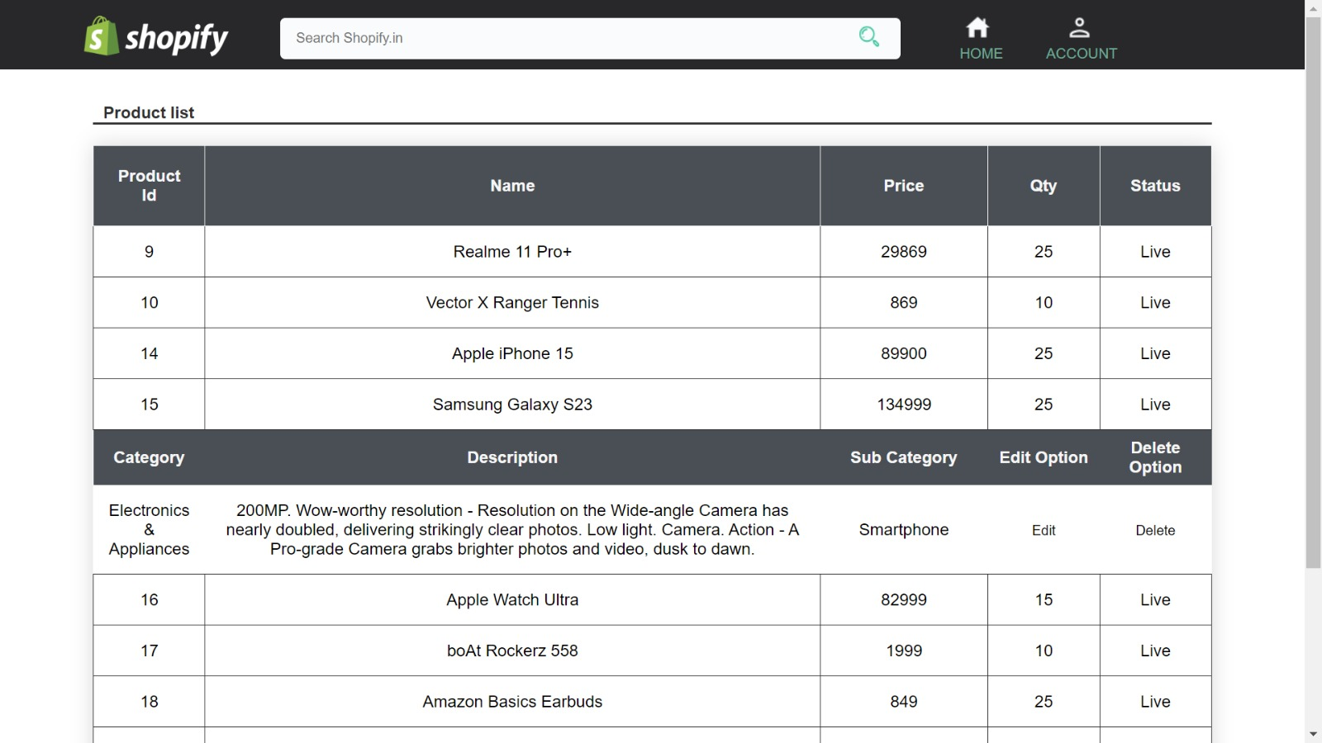

Slide 32
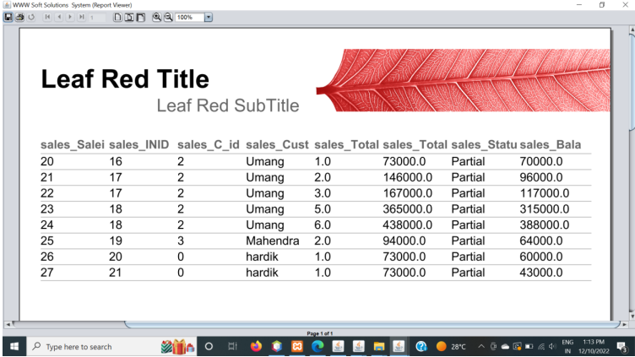
4) IR Report

Slide 33
Coding Standards
Indentation:
We have given proper indentation in our code so if any other developer reads our code then they can easily understand the code.
Naming Conventions:
We have used underscores to separate words of filename. So, it can be easily readable.
We have used camel Case format for writing file/object/function names.

Slide 34
Test Cases 1:
Lgin Case
No | Test case | Action | Expected Result | Actual Result | Status
1 | User Login with correct email id or goggle Login | Select correct email from screen | User should be able to successfully login and access the website | Login is successful and the user is able to access the website | Pass
2 | User Login with incorrect email id | Select incorrect email from screen | User should not be able to successfully login and access the website | Login is not successful and the user is not able to access the website | Pass

Slide 35
Test Cases 2: Order Product Case
No | Test case | Action | Expectd Result | Actual Result | Status
1 | Order | Fill all the field with correct information | User should be able to purchase product | User should be able to purchase product | Pass
2 | Order | Not Fill all the field with correct information | User should not be able to purchase product | User should not be able to purchase product | Pass
3 | Order | Submit blank form | User should not be able to purchase product | User should not be able to purchase product | Pass

Slide 36
Proposed Enhancements:
We will add 30min delivery option in this system. So, customer can quickly get order.
We will add a feature like If any festival offer comes then send the automatically to the user.
We will add feature like If user use more our website and purchase order then he/she will get more offer’s and Lucky drown etc...
We will add recommend system for user. So they can buy easily.

Slide 37
Conclusion
We have taken enough care to make the project user friendly and more interactive.
This system will make Student Information Management an easier job for the administrator of any organization.
This system will help in accessing any student’s information anytime and can be kept safely for long period of the time without any damage.

Slide 38
Bibliography
https://www.google.com
https://www.geeksforgeeks.org
https://stackoverflow.co
https://www.youtube.com

Slide 39
Thank You

